Slide 1
HPE Container platform administration training – MapR Management
Course ID: HG7G2S - 01129844
April 2020

Slide 2
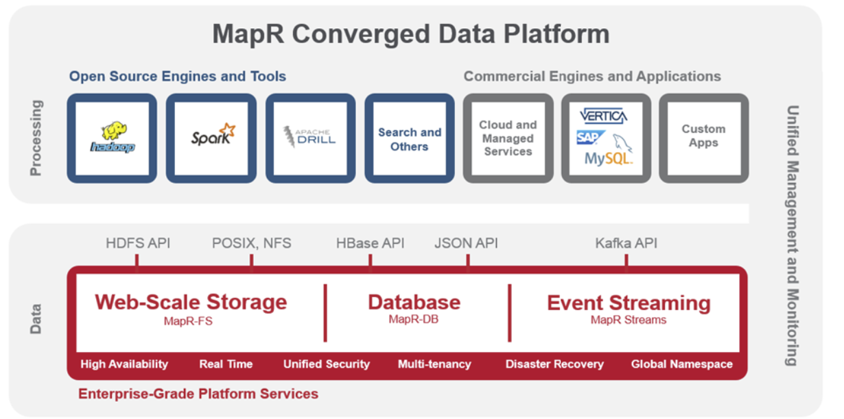
MapR Terminology
Terminology | Description
MapR Ecosystem Packs (MEP) | Set of ecosystem components that work together on one or more MapR cluster versions. For example: Hive, Pig, Spark, Ozzie
MapR System Control (MSC) | Web UI management for MapR
Container Location Database (CLDB) | Tracks critical meta data about every container in MapR-FS. Tracks fileservers in the cluster and node activity. CLDB service on multiple nodes will distributes lookup operations across those nodes for load balancing. It also provides high availability.
Warden | A light Java application that runs on all the nodes in a cluster and coordinates cluster services. Warden’s job on each node is to start, stop, or restart the appropriate services, and allocate the correct amount of memory to them.
Posix Clients | MapR POSIX clients enables docker to read and write directly and securely on the filesystem exposed by MapR FUSE (Filesystem in User space).

Slide 3
MapR Services
MapR Service | Description
AdminApp | This is the web application that allows users and administrators to control and configure a MapR cluster.
Zookeeper | ZooKeeper is a coordination service for distributed applications. It provides a shared hierarchical namespace that is organized like a standard file system.
Fileserver | MapR-fileserver service is the actual process that stores data on disks. This service needs to be running on every machine that is storing data. More file server running will increases failure tolerance and increase over all I/O bandwidth.

Slide 4

HpECP and MapR Integration
HCP Primary
HCP Shadow
HCP Arbiter
HCP Worker
HCP Worker
K8s Host
K8s Host
K8s Host
K8s Host
K8s cluster 1
K8s cluster 1
Fileserver Warden
Fileserver Warden
Fileserver Warden
Fileserver Warden
Fileserver Warden
Fileserver Warden
Fileserver Warden
Fileserver Warden
Fileserver Warden
CLDB / Zookeeper
apiserver
apiserver
ALL HOSTS WILL HAVE A MOUNTPOINT for the entire MapR file system under /opt/bluedata/mapr/mnt/hpecp.mapr.cluster (fuse mounted)
MapR components (Will be packaged as an infrastructure container)
HCP uses MapR client (not Platinum). It include MapR-FS, but not MapR Streams and MapR DB.
Fileserver is optional on any worker
MapR will be setup with "secure" mode and also with "dare" mode.
On-wire encryption and at rest encryption is enabled by default
A single MapR ticket is created for HPECP usage. (This will also be used for DataTap)
Another MapR ticket is created for csi usage.
After HCP controller installation, user can change MapR configuration (e.g. add topology - rack aware ness)

Slide 5
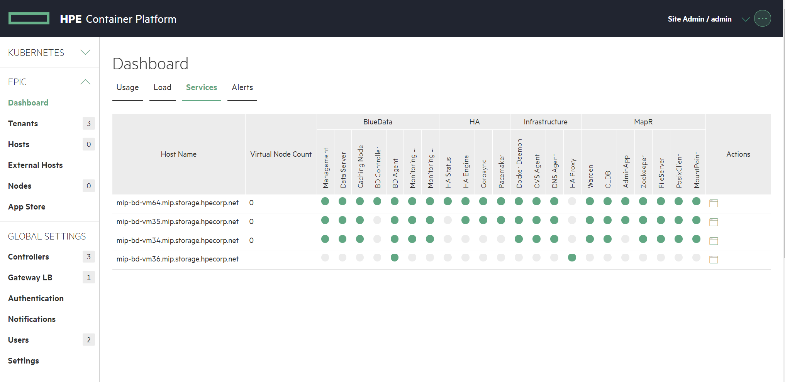
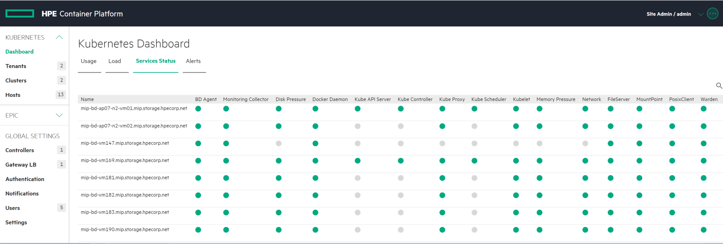
MapR Services
HPECP hosts
Monitor the health of MapR services
Kubernetes hosts

Slide 6
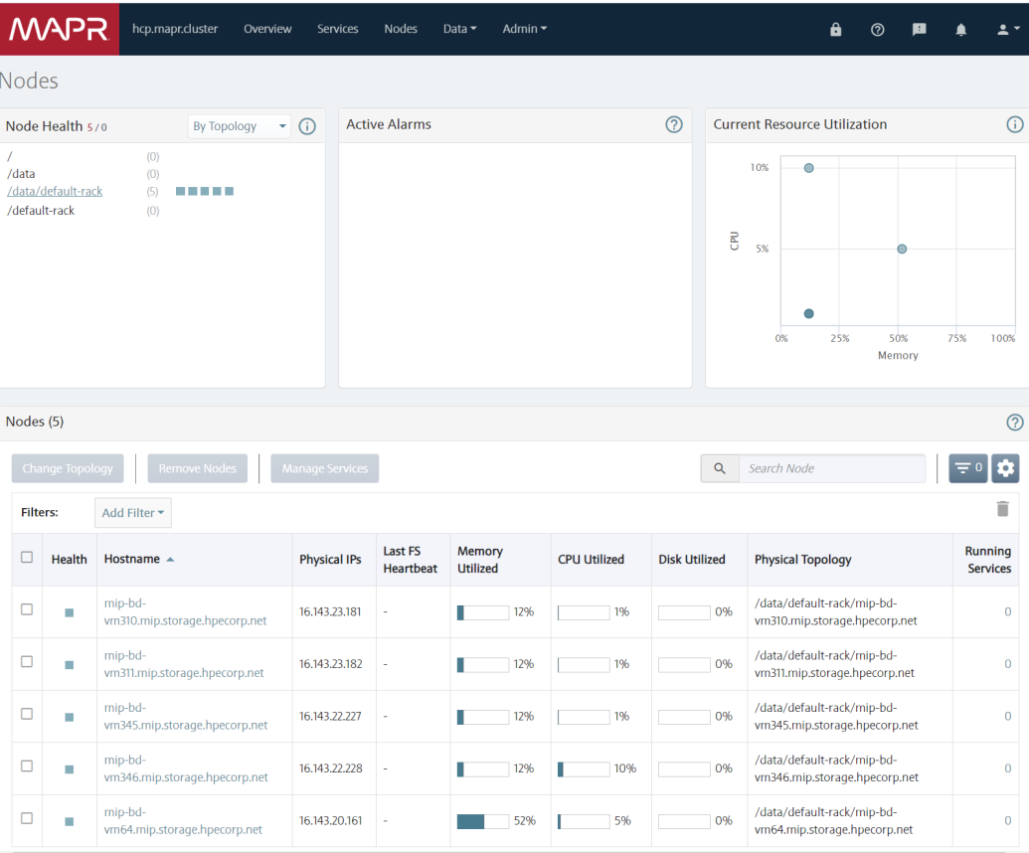
MapR Control System (MCS)
MapR control system (MCS) is installed in HPECP Primary controller and Shadow node. You can access MCS UI console at https://<HPECP Primary controller IP>:8443. The default username is “admin”. The admin password is stored on the HPECP Primary controller at /opt/bluedata/mapr/conf/mapr-admin-pass
MapR Container Location Database (CLDB) runs on HPECP Primary, Shadow, and Arbiter node. There is no CLDB UI is port #7222
# docker ps CONTAINER ID IMAGE COMMAND CREATED STATUS PORTS NAMES d68cf97fd1f6 epic/webhdfs:1.2 "httpfs.sh run" 6 days ago Up 6 days epic-webhdfs-16.143.20.161 c861437df858 epic/monitoring:1.17 "/etc/start-all.sh..." 6 days ago Up 6 days epic-monitoring-16.143.20.161 659a826f93b4 epic/nagios:2.4 "/bin/sh -c '/usr/..." 6 days ago Up 5 days epic-nagios-16.143.20.161 3a26b7547afb epic/mapr:6.1.0-GA-20200210022930 "/sbin/init" 6 days ago Up 6 days epic-mapr

Slide 7


MapR User Accounts
By default, HPECP set-up 3 MapR User Accounts:
MapR User Accounts | Description
MapR | Internal user used by HPECP
MapR-csi | Used to manage Kubernetes CSI drivers. HPECP needs to create/delete/mount volumes on Kubernetes clusters. Password is stored at /opt/bluedata/mapr/conf/mapr-csi-pass
Admin | Used to connect to MapR-FS and manage the MapR filesystem operations Password is stored at /top/bluedata/mapr/conf/mapr-csi-pass
LDAP Support:
By default, HPECP does not set-up LDAP/AD support for MapR. We use PAM/sssd inside MapR container to set-up userid authentication. (See next slide)

Slide 8
Setting Up AD/LDAP in MapR management
Step 1: Install AD/LDAP packages in the mapr container
yum install -y authconfig openldap openldap-clients pamtester sssd sssd-client –nogpgcheck
Step 2: Setup authconfig
authconfig --enableldap --enableldapauth \
--ldapserver=<ldap-server>\
--ldapbasedn=“<basedn>" \
--enablemkhomedir --enablecachecreds \
--enableldaptls --update \
--enablelocauthorize \
--enablesssd --enablesssdauth \
--enablemkhomedir –enablecachecreds
Step 3: Setup /etc/sssd/sssd.conf
…. ldap_uri = ldap://<ldap server url>:389 ldap_id_use_start_tls = True ldap_tls_cacertdir = /etc/openldap/cacerts ldap_tls_reqcert = never ldap_user_member_of = memberOf ldap_access_order = filter debug_level = 0xf0 ldap_access_filter = (|(memberOf=cn=<ldap group object>)) ldap_schema = rfc2307 ldap_user_gid_number = gidNumber ldap_group_gid_number = gidNumber ldap_user_object_class = posixAccount …..
Step 4: Restart sssd
chmod 600 /etc/sssd/sssd.conf
systemctl enable sssd
systemctl start sssd
Step 5: Test ldap user login
pamtester login <userid> open session

Slide 9



MapR Management
HPECP only install these MapR-FS components:
Controller: CLDB, Zookeeper, Warden, MFS, PosixClient and MCS
K8s: MapR-csi drivers
All the critical security files located /opt/bluedata/mapr/
Provisioning a new MapR client node
MapR client node setup require mapr-clusters.conf file. Configuration file can be retrieved : bdmapr --root cat /opt/mapr/conf/mapr-clusters.conf
If MapR node is set-up for “secure option, HPECP uses ssl_trusstore file. (/opt/bluedata/mapr/conf/ssl_trusstore)
Adding worker
CLDB

Slide 10
MapR Management Common Tasks
bdmapr is a wrapper script that sets up MapR ticket automatically
Common Task | Command to run on HCP Controller
List all nodes with services running on them along with the topology | bdmapr maprcli node list -columns h,svc,racktopo,id
List all volumes along with additional info | bdmapr maprcli volume list -columns volumename,minreplicas,numreplicas,mountdir,quota,advisoryquota,totalused
List all volumes that are present on a node | bdmapr maprcli volume list -filter -nodes FQDN_OF_THE_HOST -columns volumename,minreplicas,numreplicas,mountdir,quota,advisoryquota
List license info | bdmapr maprcli license list
Zookeeper Status | bdmapr --root /opt/mapr/zookeeper/zookeeper-3.4.11/bin/zookeeper qstatus
CLDB Master node | bdmapr maprcli node cldbmaster
List CLDB/Zookeeper Nodes | bdmapr maprcli node listcldbzks
Logon to MapR container shell | bdmapr –root bash

Slide 11
MapR Services (Troubleshooting)
MapR Service | Description | Diagnostics Steps / Corrective Action when service is down To logon onto MapR shell, run bdmapr –root bash on the HCP controller.
Container Location Database (CLDB) | Tracks critical meta data about every container in MapR-FS. Tracks fileservers in the cluster and node activity. CLDB service on multiple nodes will distributes lookup operations across those nodes for load balancing. It also provides high availability. | Look at /opt/mapr/logs/cldb.log Restart CLDB services. See https://mapr.com/docs/61/ClusterAdministration/nodes/restart-srvcs.html
Warden | A light Java application that runs on all the nodes in a cluster and coordinates cluster services. Warden’s job on each node is to start, stop, or restart the appropriate services, and allocate the correct amount of memory to them. | Look at /opt/mapr/logs/warden.log Refer to troubleshooting steps as described in this link: https://mapr.com/docs/61/AdvancedInstallation/BringingUptheCluster-Troubleshooting.html Consider restarting Zookeeper and Warden services. See https://mapr.com/docs/61/AdvancedInstallation/Start_zookeeper_warden.html
Posix Clients | MapR POSIX clients enables docker to read and write directly and securely on the filesystem exposed by MapR FUSE (Filesystem in User space). | Look at the /opt/mapr/logs/posix-client-basic.log Turn on mapr tracing to collect more information. See https://mapr.com/docs/60/AdministratorGuide/MapRfusePOSIXClient-Troubleshooting.html
AdminApp | This is the web application that allows users and administrators to control and configure a MapR cluster. | Look at /opt/mapr/apiserver/logs/apiserver.log The admin application is normally controlled by the warden process which should restart it if it fails. The primary repair action is to tell the warden on the appropriate node to restart this service.
Zookeeper | ZooKeeper is a coordination service for distributed applications. It provides a shared hierarchical namespace that is organized like a standard file system. | Look at the /opt/mapr/zookeeper/zookeeper-3.4.11/logs/
Fileserver | MapR-fileserver service is the actual process that stores data on disks. This service needs to be running on every machine that is storing data. More file server running will increases failure tolerance and increase over all I/O bandwidth | Look at the /opt/mapr/logs/mfs.log*. The warden will try three times to restart the service automatically. After an interval (30 minutes by default) the warden will again try three times to restart the service. The interval can be configured using the parameter services.retryinterval.time.sec in warden.conf file. If the warden successfully restarts the FileServer service, it should return back to green status. If the warden is unable to restart the FileServer service, it may be necessary to contact HPE technical support.

Slide 12
Summary | Description
LDAP/AD integration for Datafabric | MapR relies on pam configuration for user authentication. We have to configure SSSD module inside the MapR infrastructure container (On all controller nodes - primary, shadow and arbiter) to allow the CLDB process to validate uid and gid for an incoming file/directory request. Proposal 1 – Different LDAP/AD configuration for data fabric access Site Admin creates one or more ldap/ad domains with each domain consisting of one or more LDAP/AD groups. • HPECP will create a separate SSSD domain for each domain specified along with all the groups. Proposal 2 – Managing the SSSD settings through existing tenant configuration When a tenant is created with LDAP/AD group, HPECP will create one or more SSSD domains for that tenant
Able to create more volumes for a tenant and also create shareable volumes for tenants | Site Admin must be allowed to create one or more volumes and provide access to one or more tenants. These volumes will be exposed as different datataps/fsmount for the tenants. Tenant Admin must be allowed to create one or more volumes for that tenant. These volumes will be exposed as different datataps/fsmounts for the tenant We should allow this only if LDAP/AD is integrated, so we can set perms on the created volumes When all tenants share a single volume, this will result in performance/scalability issues.
External MapR cluster | Separate mapr posix client into a separate mapr image Add external mapr as system storage.
Providing access to local MapR from MapR virtual cluster | Management provide ssl_truststore and mapr-clusters.conf throug platform info for guestconfig. Guestconfig must merge the ssl_truststore and setup mapr-clusters.conf on all the mep nodes. We should allow this only if LDAP/AD is integrated.
Able to generate user tickets for Spark/Drill operators | This can only be allowed if LDAP/AD is integrated For a k8s tenant, through REST API, allow creating a user secret. User has to provide his AD credentials

Slide 13
Administration node for DataFabric
Client Edge node for DataFabric
Use MapR Tenant tickets for K8s cluster CSI driver | Currently we create one global user mapr-csi and one ticket which is used by all kubernetes clusters. That means any k8s clusters are able to access all volumes associated with other k8s clusters. We should change this to create per k8s cluster user and ticket. MapR supports tenant type tickets which should leverage it.
Role and Data Balancer needs to be turned-on for better performance | Can this be done at MCS?
MSC UI to be exposed in HCP UI | Do we really need this?
Need option to disable encryption at the time of install | Can this be done at MCS?
Site Admin Web Terminal to manage persistent data fabric via MapCLI | As a site admin responsible for operations of the persistent data fabric (e.g. create volumes, change advanced parameters for replication, snapshots etc), I want a secure way to perform these advanced operations that are not available in MCS UI (or without directly SSH'ing into the controller host running the MapR master node) so that I can support my end users (data engineers, data scientists etc). Acceptance Criteria: Command line interface available as soon as HPE CP control plane is setup Prefer web based interface with security AD/LDAP authentication prior to accessing this web interface Allow for multiple site admins to interact with this web interface without collision. Audit log of all operations performed by this site admin/operations persona in a centralized location, ideally available for viewing through the web interface
Auto configure AD/LDAP in the base for persistent data fabric | Auto configure AD/LDAP in the base for persistent data fabric

Slide 14




DataTap / MapR Improvements
NODE
HPE Container Platform
NODE
POD
POD
POD
POD
NODE
NODE
POD
POD
Container Root Filesystem
(Ephemeral)
FSmount/Dtap
(Persistent)
Container Root Filesystem
(Ephemeral)
FSmount/Dtap
(Persistent)
Container Root Filesystem
(Ephemeral)
FSmount/Dtap
(Persistent)
FSmount/Dtap
(Persistent)
FSmount/Dtap
(Persistent)
HPE Persistent Data Fabric
raw disk
raw disk
raw disk
Preserving UID/GID:
Preserving UID/GID for DataTap when connecting to local MapR cluster through FSmount browsing UI
Preserving UID/GID for DataTap when connecting to local MapR cluster
Data Fabric
DataTap/FSmount support for remote MapR

Slide 15
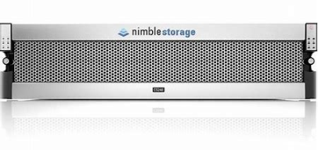
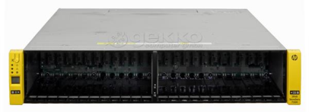


MapR Optimization for Nimble Storage & 3 PAR
NODE
NODE
NODE
NODE
POD
POD
POD
POD
POD
POD
POD
POD
Container Root Filesystem
(Ephemeral)
FSmount/Dtap
(Persistent)
Container Root Filesystem
(Ephemeral)
FSmount/Dtap
(Persistent)
Container Root Filesystem
(Ephemeral)
FSmount/Dtap
(Persistent)
Container Root Filesystem
(Ephemeral)
FSmount/Dtap
(Persistent)
Container Root Filesystem
(Ephemeral)
FSmount/Dtap
(Persistent)
Container Root Filesystem
(Ephemeral)
FSmount/Dtap
(Persistent)
HPE Persistent Data Fabric
HPE Persistent Data Fabric
Need Optimization
Need Optimization
NODE
NODE
POD
POD
POD
POD
Container Root Filesystem
(Ephemeral)
FSmount/Dtap
(Persistent)
Container Root Filesystem
(Ephemeral)
FSmount/Dtap
(Persistent)
Container Root Filesystem
(Ephemeral)
FSmount/Dtap
(Persistent)
HPE Persistent Data Fabric
Optimized
raw disk
raw disk
raw disk

Slide 16

Q&A

Slide 17
THANK YOU

